Slide 1


Slide 2
The French Shooting Federation
is PLEASED
to invite YOU to

Slide 3
EUROPEAN
CHAMPIONSHIP
SHOTGUN 2020
Last QUOTAS for TOKYO OLYMPIC GAMES

Slide 4
In the brand new range of
Châteauroux

Slide 5


Slide 6
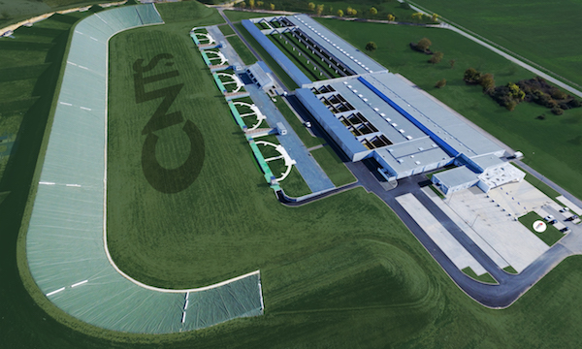

Slide 7
THE
SHOOTING
RANGE
Few pictures

Slide 8
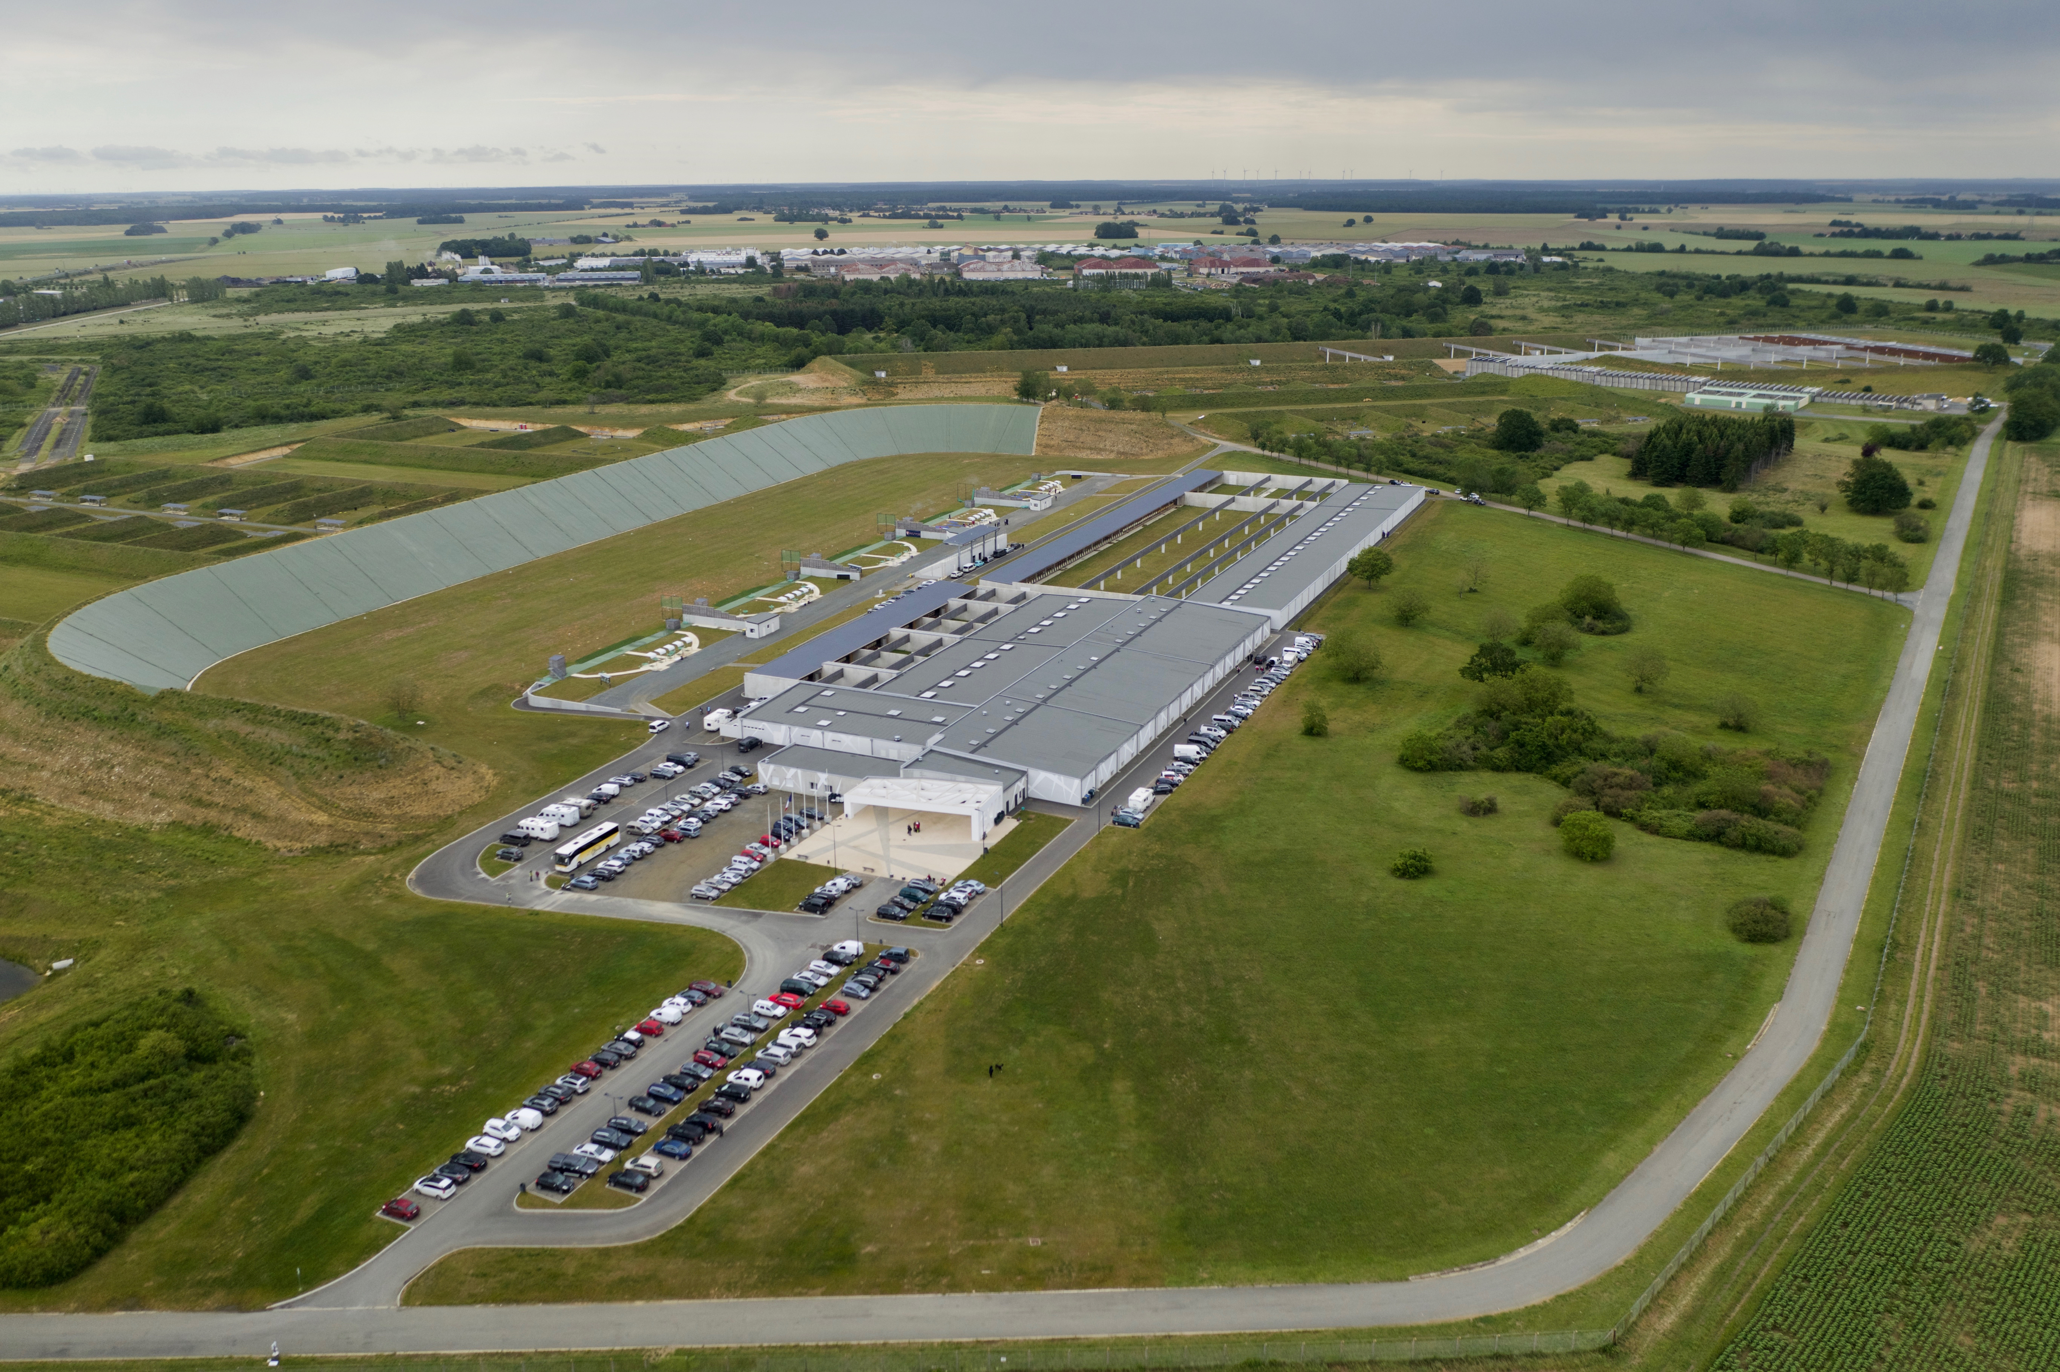

Slide 9
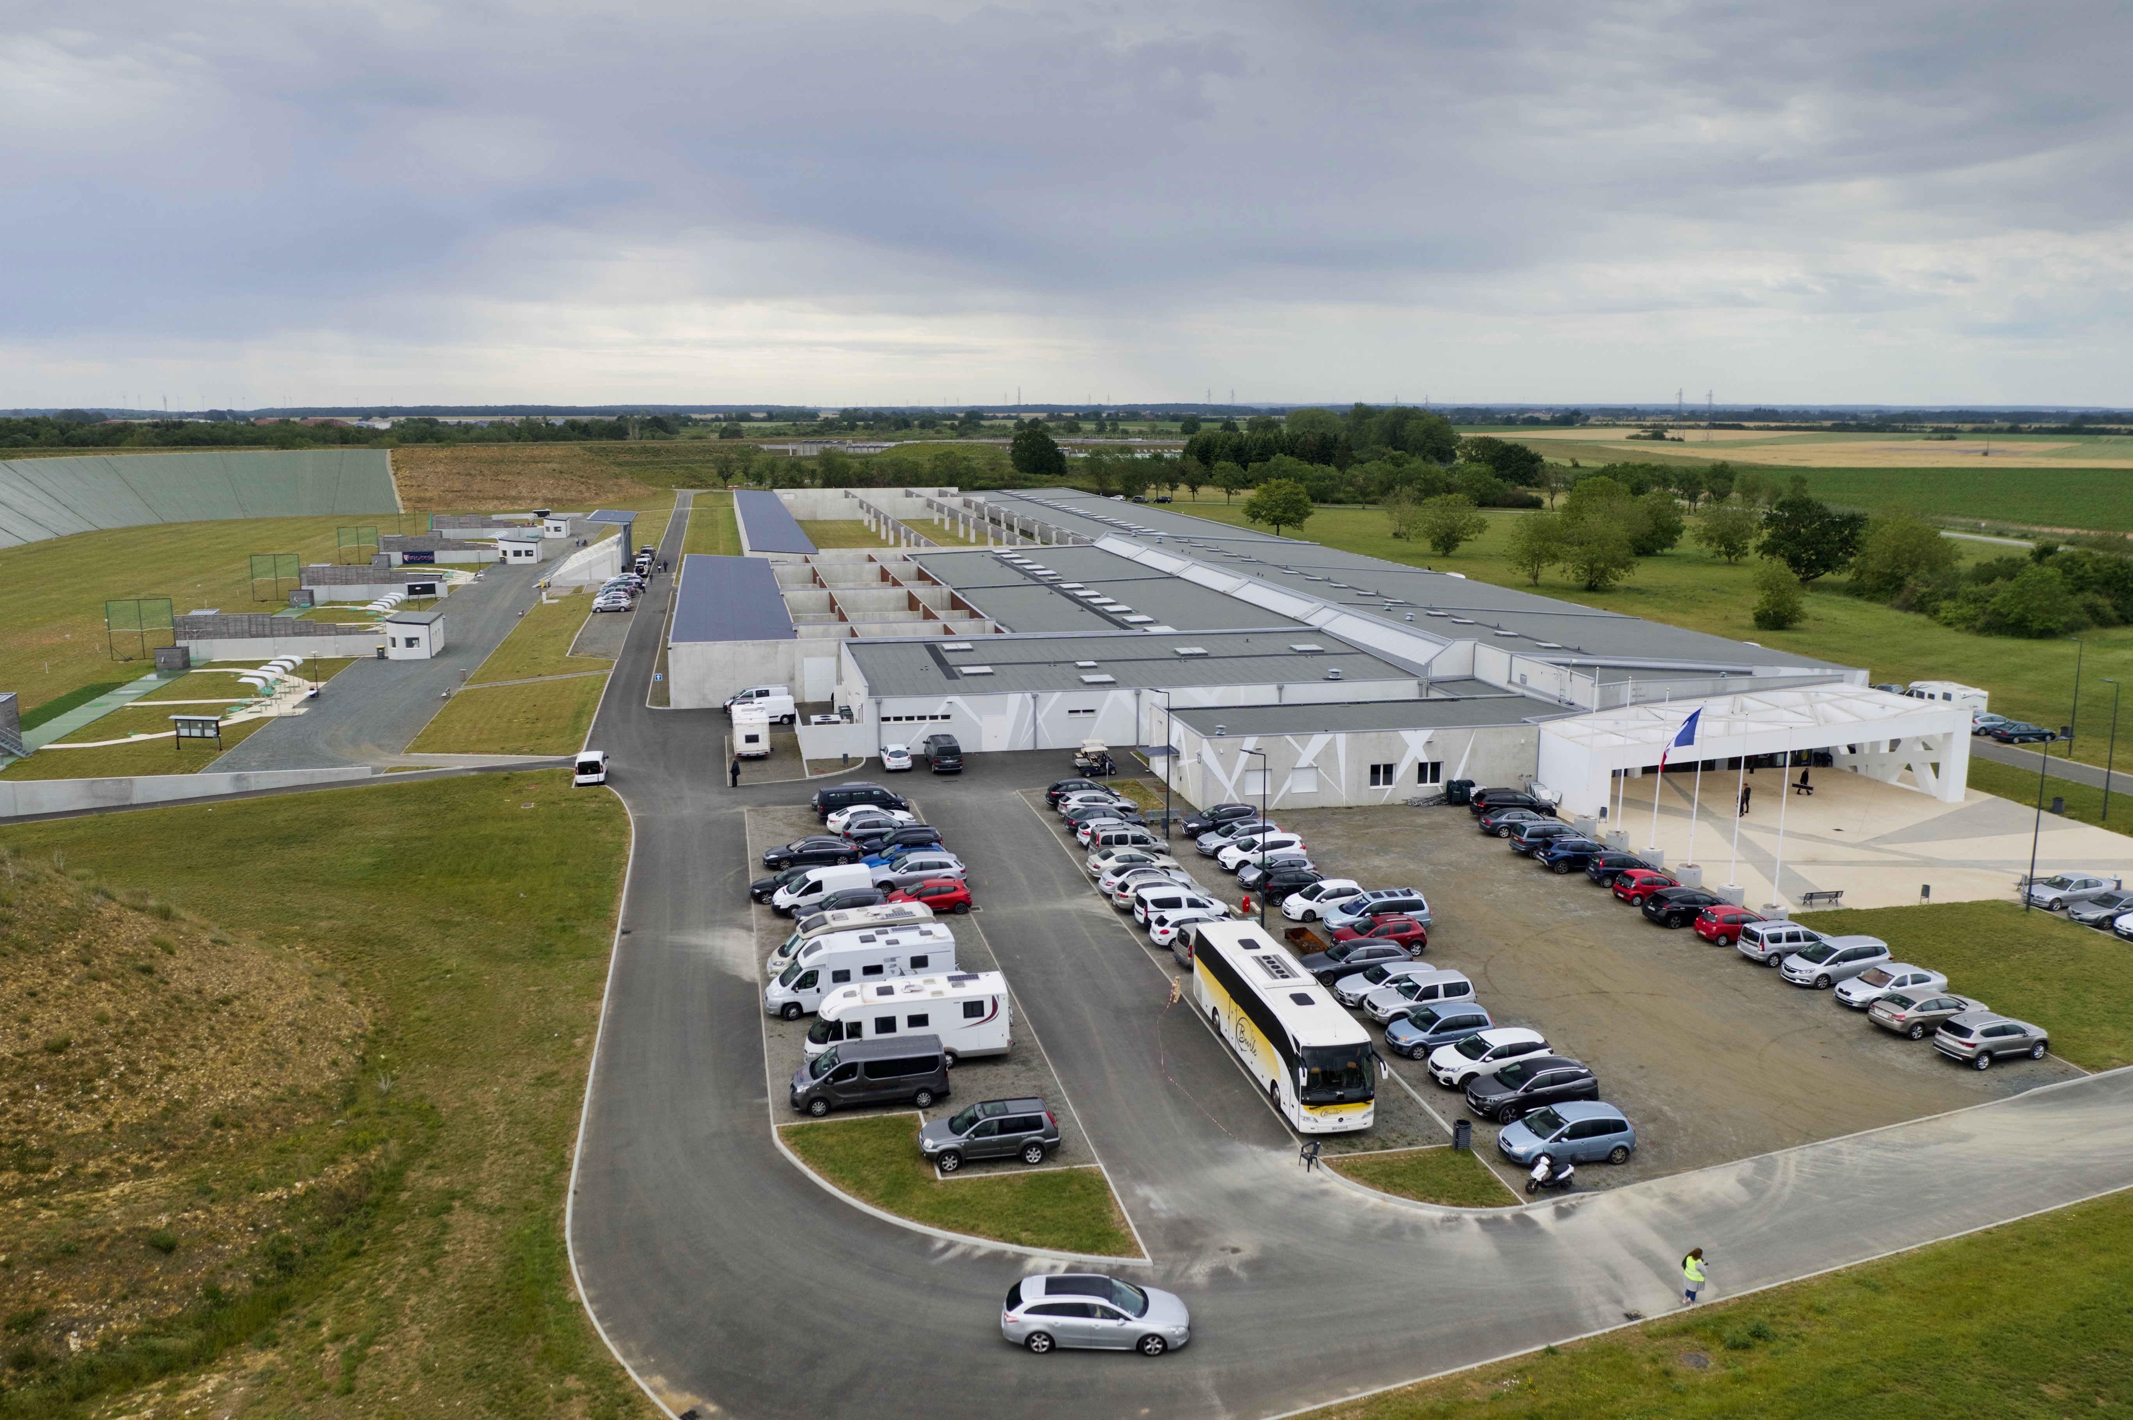

Slide 10
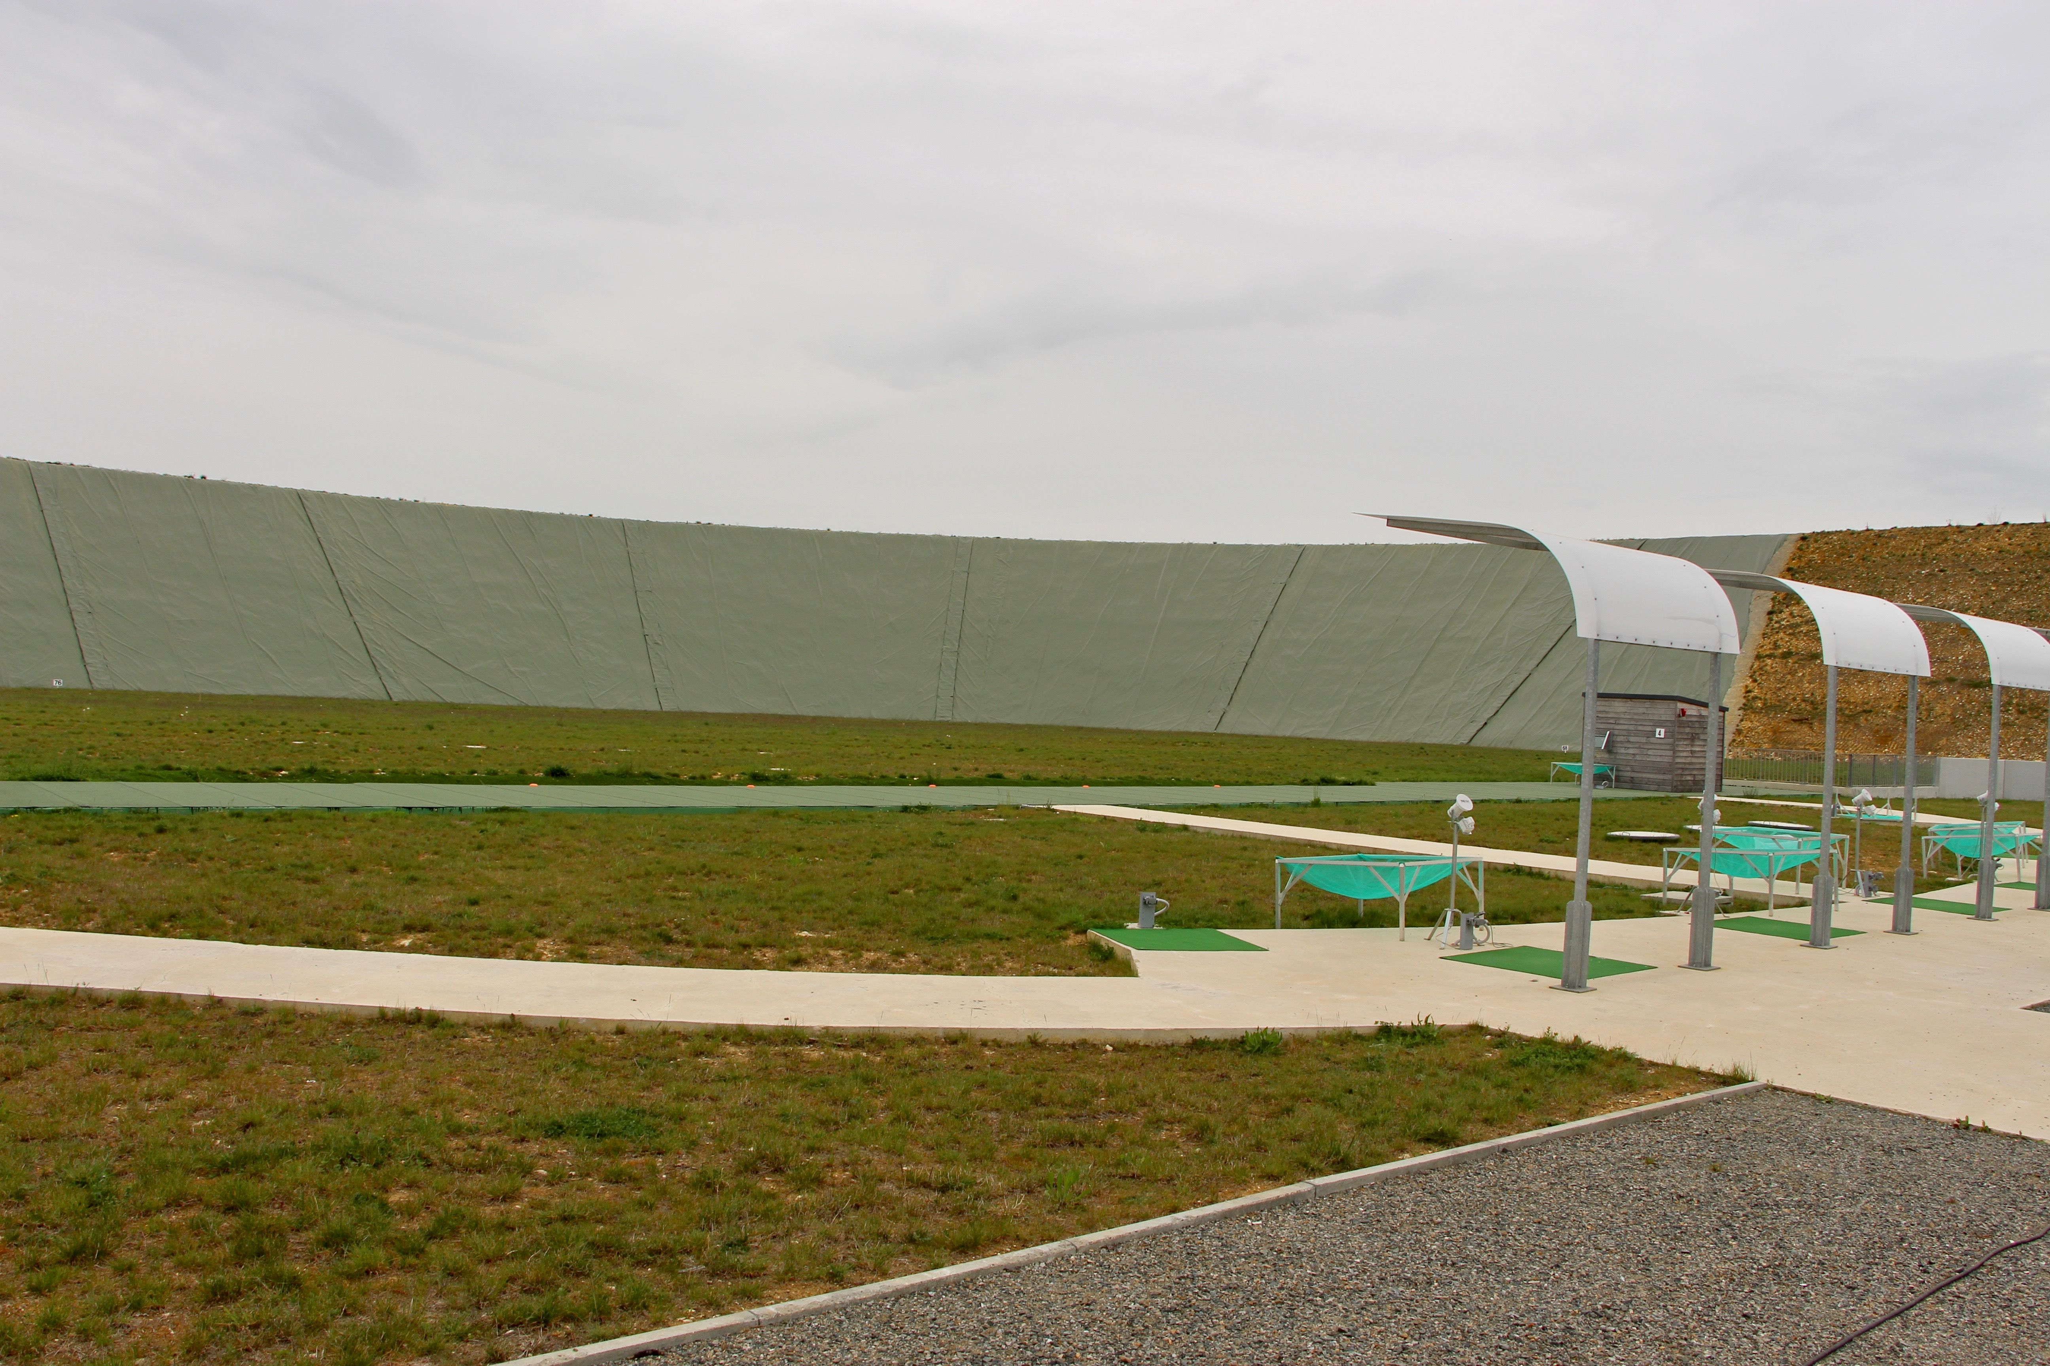

Slide 11
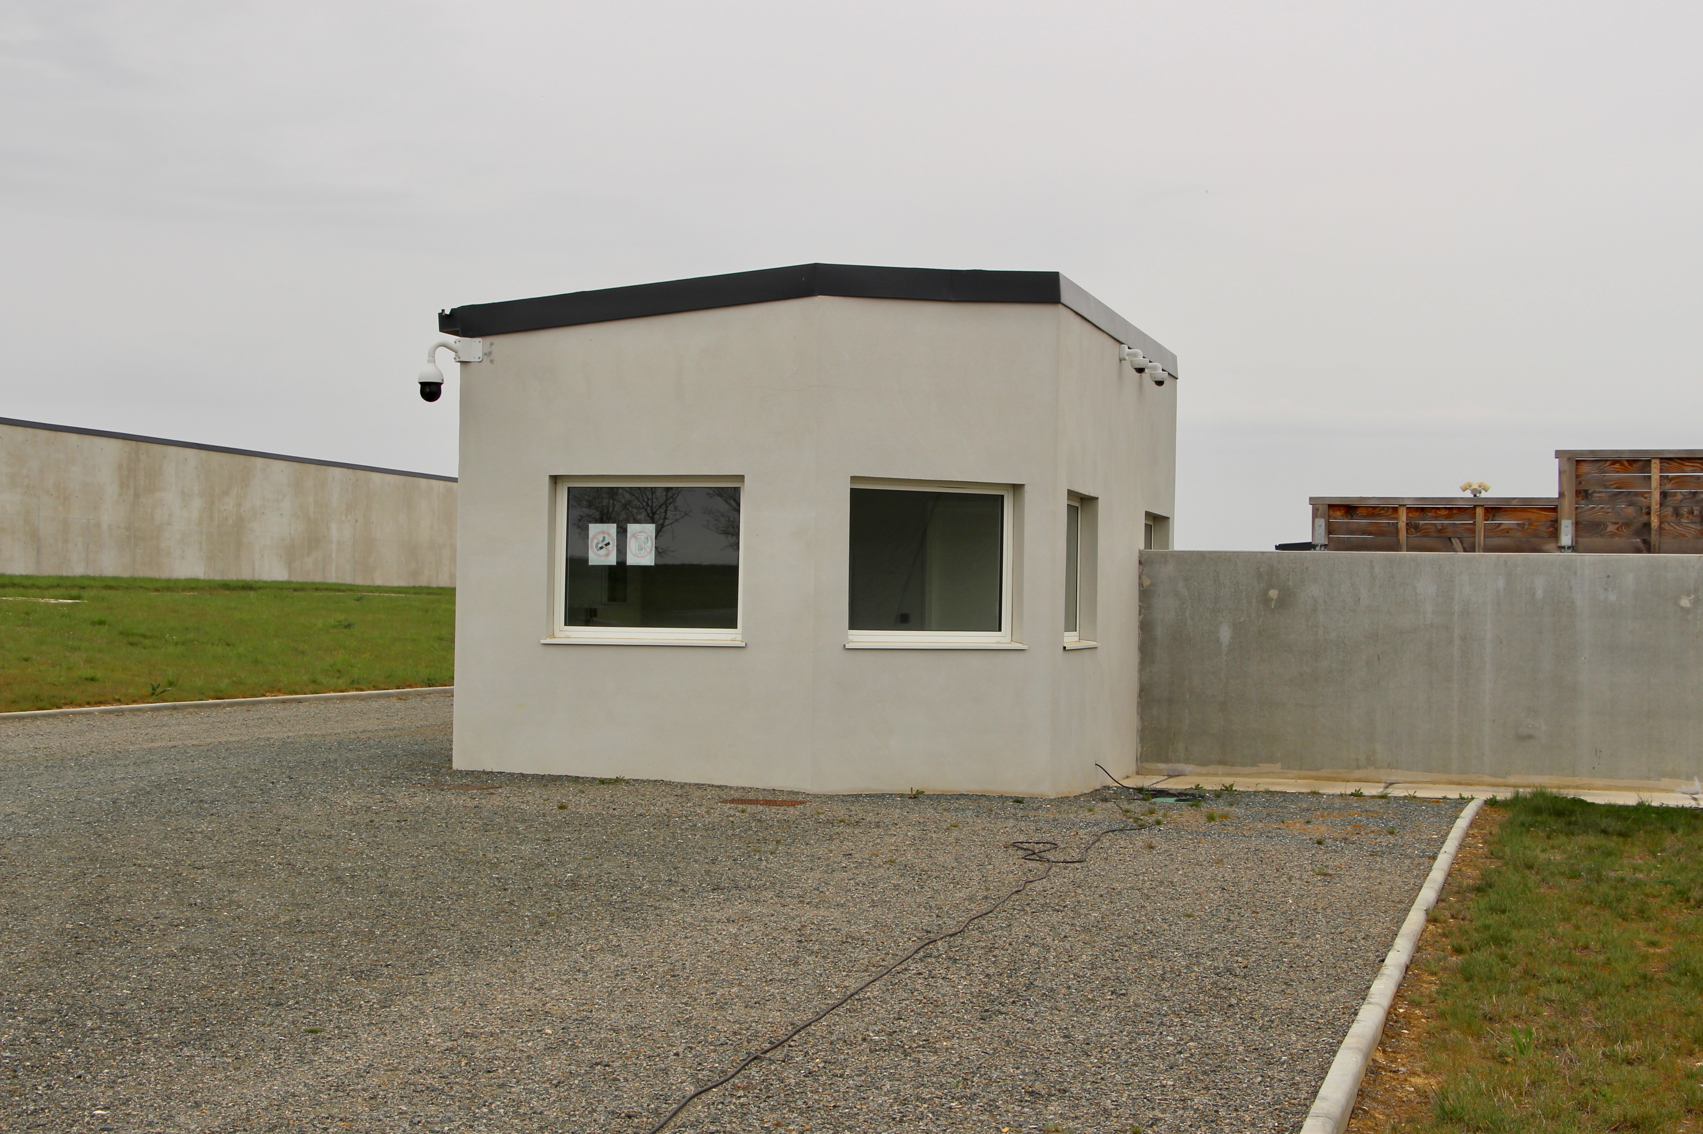

Slide 12
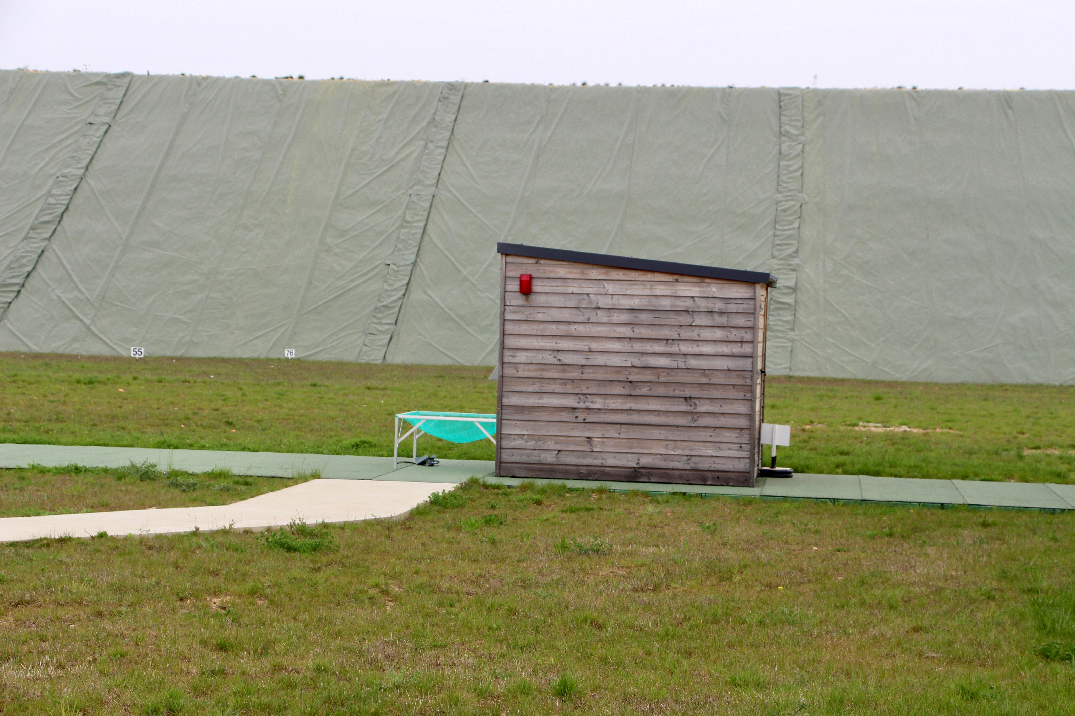

Slide 13
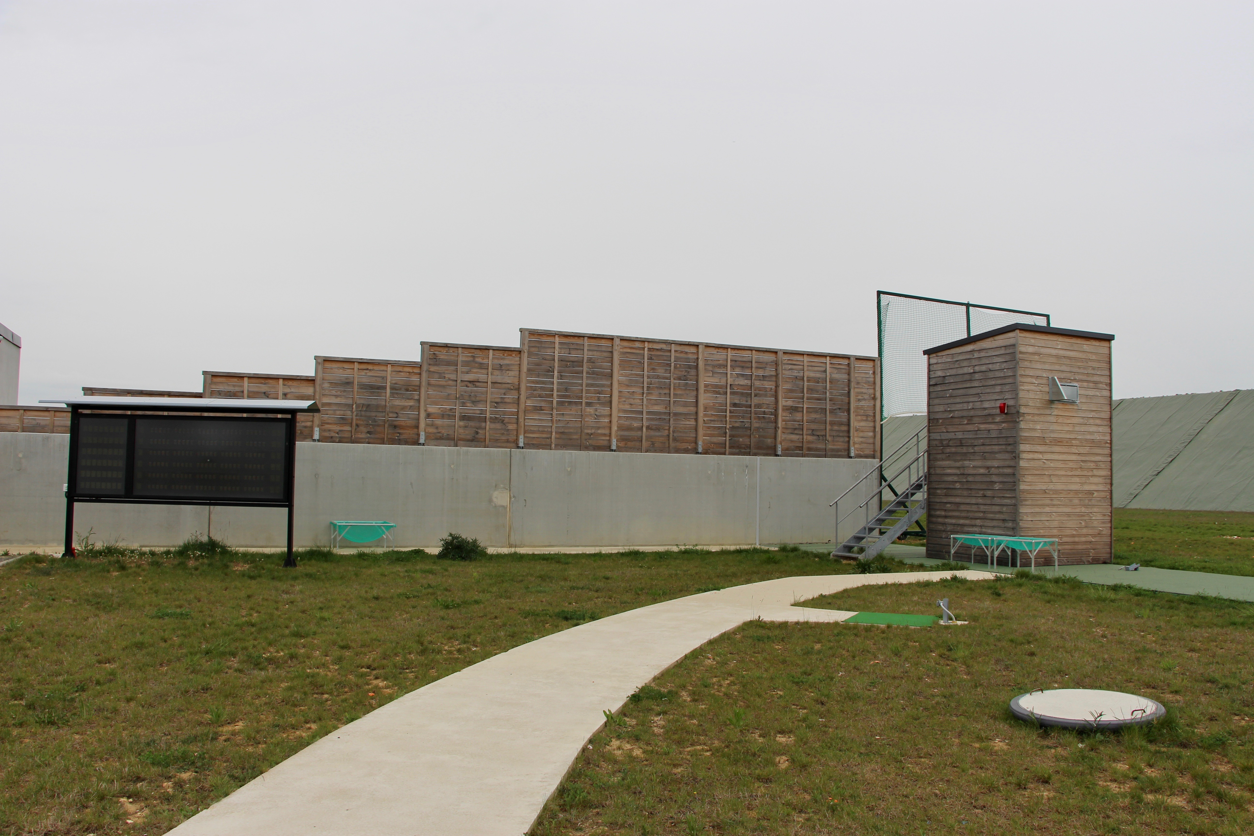

Slide 14
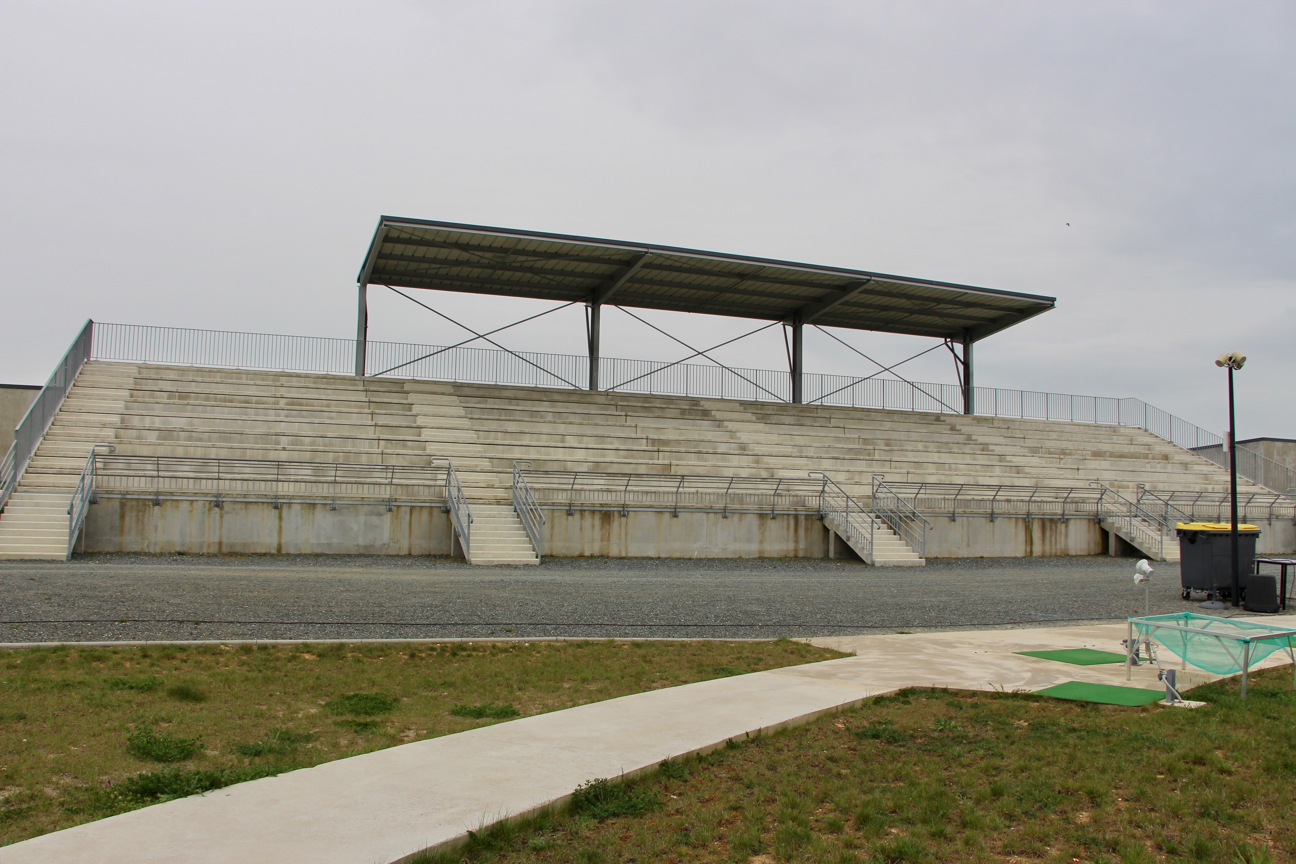

Slide 16
Best in class
RANGE EQUIPMENT

Slide 17
Acoustic Release system: PROGETTI
Launcher: LAPORTE
Electronic Scoreboards: PROGETTI
Clay Targets: LAPORTE

Slide 18
New range
BUT
Competition experience

Slide 19

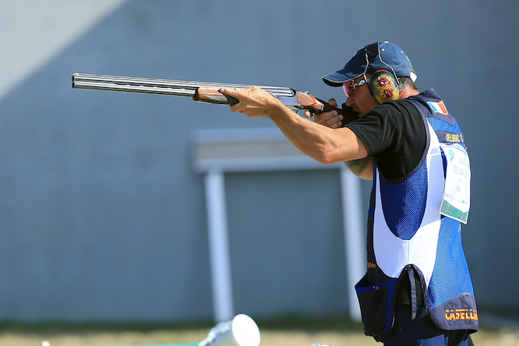
SUCCESSFULL WSPS
WORLD CUP 2018

Slide 20
Hotels & Transportation

Slide 21
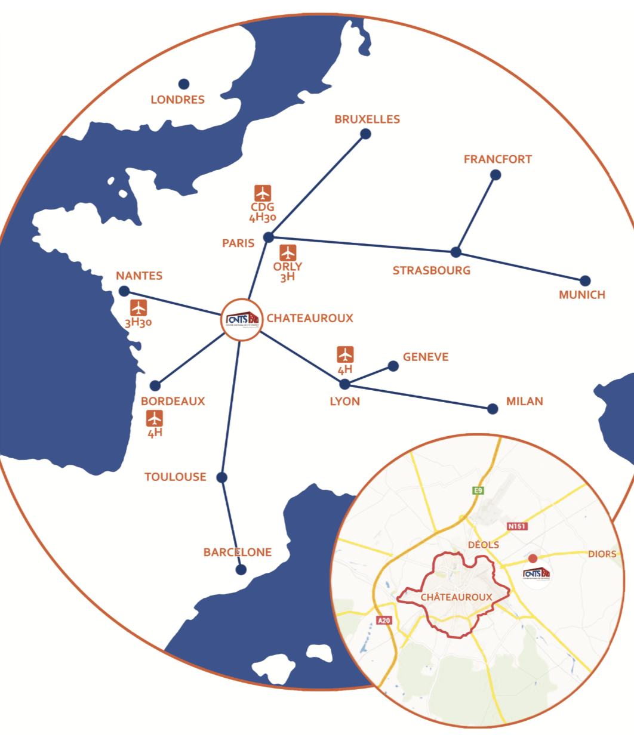

Slide 22
Shuttles from both Paris airports
Shuttles from the hotels to the range
About 20 hotels booked for the delegations
3 areas for the hotels
      Châteauroux : 15/20 minutes to the range
      Issoudun : 30 minutes to the range
      Vierzon : 45 minutes to the range

Slide 23
RESTING AREA

Slide 24
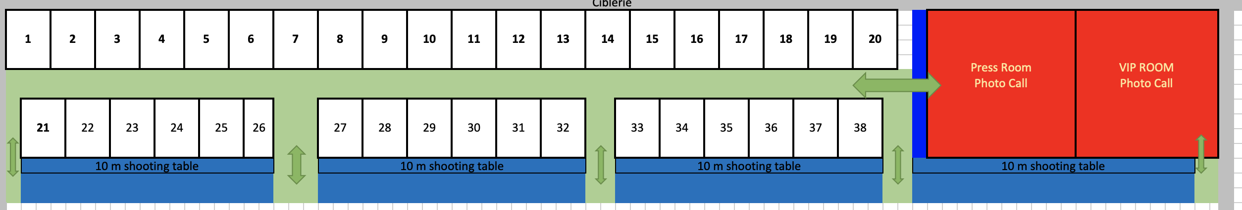
On 10 m range: a 4X3 m space for each nation, more for big delegation
Air conditioned - Ideal if high or law temperature outside
Shooting range, ceremony area, press room, restaurant at 50 m of the resting area

Slide 25
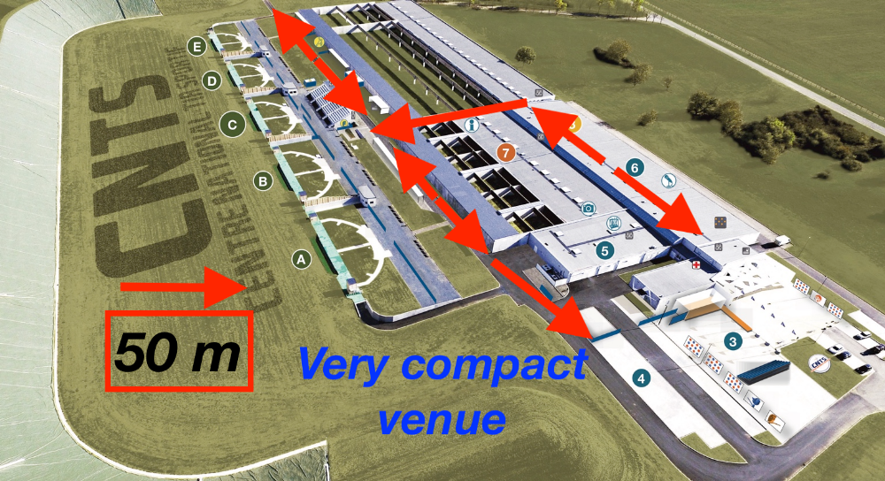

Slide 26
COMMUNICATION PROGRAM

Slide 27
2 National TV Chanels broadcast finals
        L’Equipe ("best sport" in France
        Sport en France ( NOC' TV Channel )
FFTir produces a TV signal for each nation
All finals are streamed on internet channel

Slide 28
The BEST preparation to get the
LAST QUOTAS for TOKYO 2020

Slide 29

French Grand Prix
3 weeks before
EUROPEAN CHAMPIONSHIP
13th to 18th of April 2020

Slide 30


Slide 31
Thank you to ESC
Thank you to Technical Delegate
Thank you to ECH Lonato 2019
Thank you to all of you!!!

Slide 32
Thank you for your attention
Any questions ?

